Slide 2
Intro to HTML

Slide 3
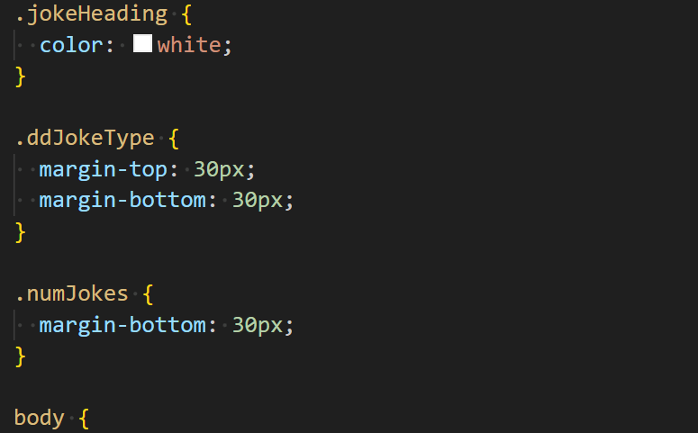
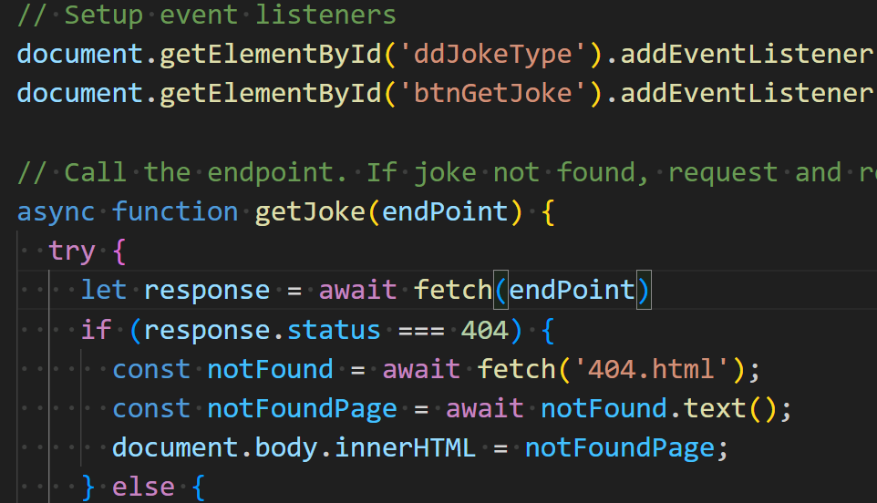

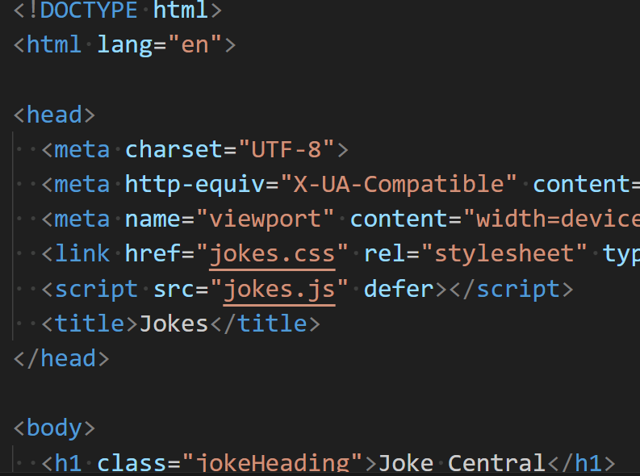

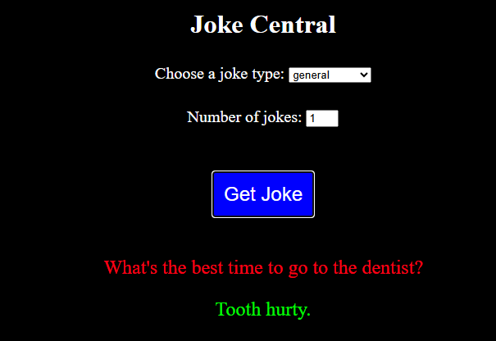
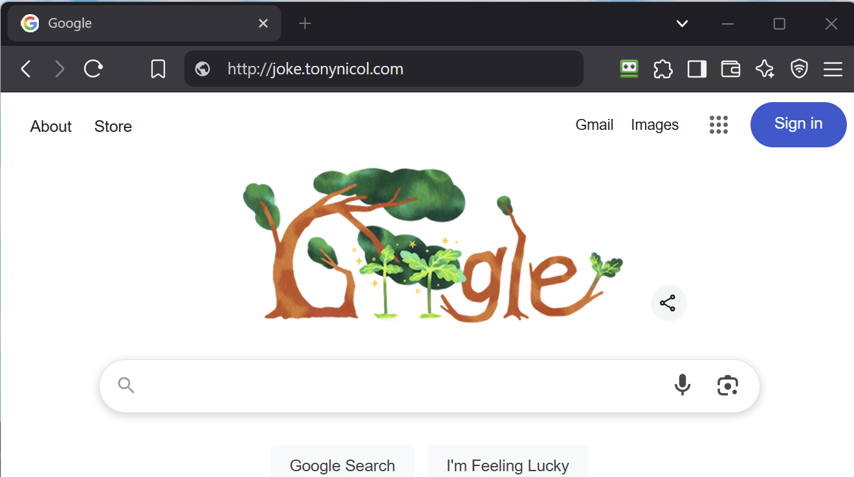
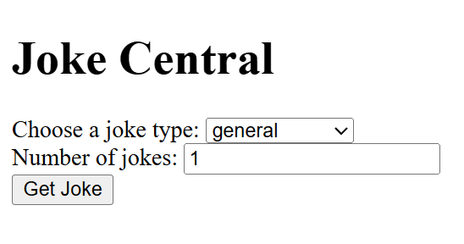
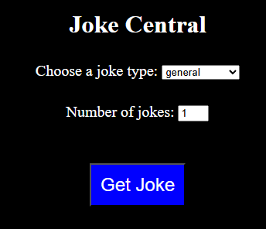


3-tier Architecture Demo
Overview of browser interaction - then focus on individual front-end areas of html, css and JavaScript
Domain Name System
Azure, AWS, Google, Oracle Cloud Services
IP Address
20.26.222.217
Return web pages
Web Server
20.26.222.217/jokes.js
App Server
Run apps & return results
joke.tonynicol.com/index.html
20.26.222.217/index.html
20.26.222.217/jokes.css
DB Server
Store and retrieve data
Physical or
Virtual Machine
Demo joke site in debugger
Notes:
Run animation
Run real joke.tontnicol.com - Show how html is fetched, css and javascript
We will start with html

Slide 4
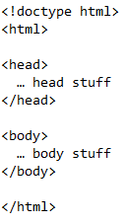
HyperText Markup Language - HTML
Used to create the web page content
Browser reads HTML as text from a web server (or file store), interprets it and responds accordingly – generally by requesting more resources and rendering html onto the screen
Syntax of language: <start-tag optional-attributes>content<end-tag> - this is an html element
Attributes are of the form: attributeName = “value”
End-tag is the start-tag name prefixed with / (there are minor exceptions)
HTML document structure:

Slide 5
Semantic elements
Semantic elements (there are many) describe the purpose of the content within them
These tags don't "do" anything other than describe structure and intent of their content
<header> Introduces a page or section </header>
<nav> Holds navigation elements like menus </nav>
<main> The main content of the page </main> can only have one of these per page
<footer> This is the closing information of a page/section </footer> e.g. copyright, date etc
So if they don't do anything, why have them?
Accessibility is a key use
Screen readers can use these hints to determine how to navigate the page
Provides visually impaired users with a structure of the page as they can't see it
We can use semantic elements to describe content and images
A user can jump to areas of the page they are interested in rather than listen to everything being read out
Search Engine Optimisation
Search engines can recognise which parts of the page matter most
I won't dwell on these to start with, but you need to be aware of them
Accessibility compliance is a moral and legal obligation

Slide 6
Some initial basic HTML
<!DOCTYPE html> : Signal that the document is HTML 5 or "modern"
<html> … </html> : Start and end of all your html in the file
<head> … </head> : appears in the html block and provides the browser with metadata
<body> … </body> : appears in the html block under the header block. This is renderable data
<title> … </title> : appears in the head block - puts the page title in the browser tab
<h1>text</h1> to <h6>text</h6> : Marks the enclosed text as a heading and default styles it
<p>text</p> : Marks the enclosed text as a paragraph
<br> : Inserts a line break. No need for an end tag as there is nothing to end – all info needed is in the start tag
<img src=“URL/filename”> : Load and display an image. No end tag. src is a necessary attribute. Other useful attributes include height, width, alt (for accessibility and missing image) and title (for mouse rollover tip)
<a href=“url”>text</a> : Anchor tag. This is a hyperlink. Text is displayed and underlined
Notes:
p tab will expand p as will others like img

Slide 7
Try this
Create an html file. Just click the +doc icon in vs code explorer then save it as say, ex1.html
Press ! then enter to create the boiler plate
In the title element, give it a title. This will show in the browser tab
in the body add <h1>First Web Page</h1> or whatever you want
To “run” the page, press F5. When given an option choose chrome or whatever browser you are using
A new window will open with your page in it
Leave it open and add a paragraph <p>This is easy</p> or whatever
Press the refresh button in the debugger or browser and the page will update. It makes life a lot easier if you have two monitors – otherwise, tile your windows
That’s it – you now know the process so – back to the slides …

Slide 8
Interactive exercise
Create a new file
Create a browser tab title with “First HTML”
Add heading level 1 containing “My first web page”
Add some paragraph text under the heading to introduce the page
Add a sub-heading level 2 under the paragraph to introduce an image
Add a paragraph to describe an image
Add the image you described and ensure it is accessible and has a rollover hint. Set the image width and height to something sensible for the page
Add some paragraph text which includes a link to a web site – e.g. Google
/demos/html - various
Notes:
Download an image of anything into your folder. https://pixabay.com/ has some free ones but DWP blocks it
Need to add an image into the downloads on onedrive

Slide 9
Cascading Style Sheets - CSS
Used to style the page content
Used for presentation – not content
Colour, layout, font type and size etc
Syntax
Selector {property:value;}
Selector is the item to style. Can be an HTML element or user defined ID or class - class is a misleading name
p { color: red; } will colour all paragraph text red
#myStuff { color: blue } will colour only one element I’ve labelled with an id=“myStuff”
Class can be used to style multiple elements
Style can appear in html, or in a style block in the html file but for maintainability, use a separate file
Adding into html tightly-couples content and presentation - but there are always exceptions
Adding to a style block in the html may be more acceptable if the style is specific to that page and only that page. It doesn't promote reuse, so separate file is by far the most popular
In a separate file, the styles can be included in other web pages so loosely-couples presentation and content, manages the separation of concerns and promotes reuse
e.g. Corporate colours change or change colour scheme for visually impaired people
Notes:
Loose coupling is a software and architectural principle where one component does one thing and only one thing very well.
Separation of concerns is a software and architectural design principle where components are self contained and do just one thing. Effectively building blocks. Like components in a car - each does its own thing and is connected to others but can be replaced without affecting the rest of the car. e.g. bolted in place as opposed to welded. This promoted reuse

Slide 10
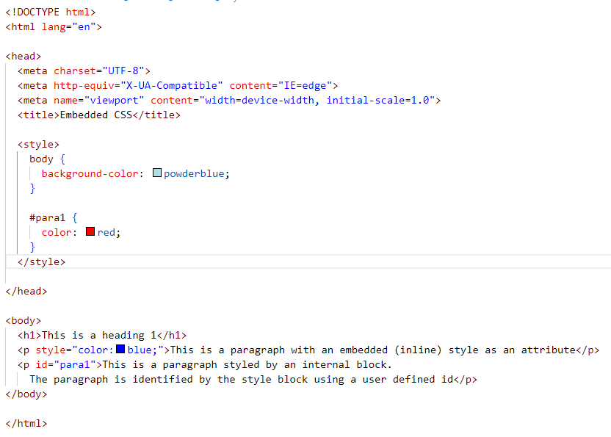
Embedded CSS
/demos/html_basics/ html-with-embedded-css.html
Notes:
Styles are in the html file
Discuss install of live preview

Slide 11
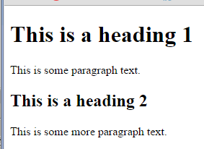
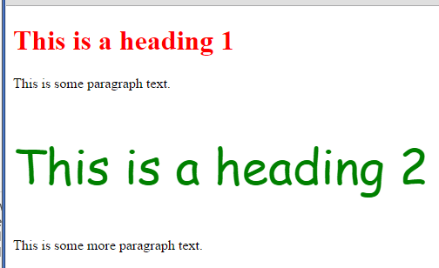
Example of using an external style sheet
/demos/html_basics/ html-with-external-css.htm
h1
{
color:red;
}
h2
{
color:green;
font: 55px "comic sans ms";
}
<!doctype html>
<html>
<head>
<link href=“css/ex2b.css" rel="stylesheet">
</head>
<body>
<h1>This is a heading 1</h1>
<p>This is some paragraph text.</p>
<h2>This is a heading 2</h2>
<p>This is some more paragraph text.</p>
</body>
</html>
Notes:
Generally better to put them in an external file. e.g. Corporate colours for every web page. Include the css file and all pages are styled the same. Change the style and it changes all pages

Slide 12
CSS Selectors
There are many selectors. The top 5 are:
1. Class - selects multiple elements. Declare with . and select with class
Can specify multiple classes
<p class="large-font highlight">Yet another paragraph</p>
2. Elements - p, h1, img etc
img { width: 300px; }
3. Descendent selectors - target one element within another
div img { width: 500px }
.div-style img { width: 200px }
4. Child selectors - target the child, grand-child etc of an element
body > .div-style > p > strong { color: red; }
5. Pseudo classes - :hover, :focus, :first-child
button:hover { background: #5f9fef; }

Slide 13
CSS Precedence
It can be confusing sometimes as to why your styles don't seem to work as you expect
There is a precedence which is basically:
Highest to lowest
!important - overrides all except another important. Attach the flag to a css value. Use by exception
Inine style - is effectively worth 1000. This tightly couples the style to the content
Specificity - the more specific, the higher the priority. They are awarded values
ID selector: 100
Class / attribute / pseudo-class: 10
Element selector: 1
This is written in a shorthand format of (a,b,c) tuple. a=num IDs, b=num classes, c=num elements
1 id + 2 classes plus 1 element would be (1,2,1) so value of 121
If there are combinations of selectors, then each is given a value and the precedence is the sum
Inline is not included in the calculation and is so high, it can't be overridden other than !important
Source order - if the precedence is equal, the later definition wins

Slide 14
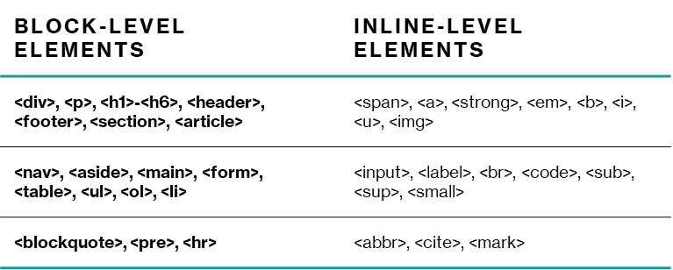
Layout
Block starts on a new line, takes full width of parent, can contain inline and block elements
Inline doesn't start on a new line, takes only as much width as needed, can contain only inline elements

Slide 15
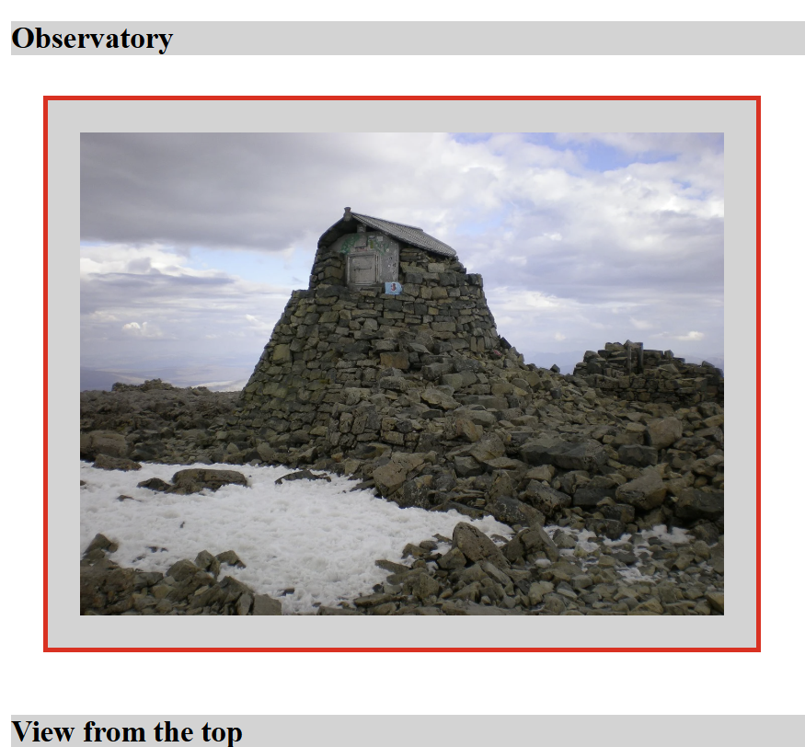
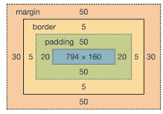
CS Box Model

